Slide 1
Startups
Lean
Fluffy

Slide 2

Lean Fluffy Startup?
Lean Thinking
Cloud Computing
Small Company

Slide 3






Old School Startup
Code incognito for a year
Get VC’s to believe
Invest lots of
$$$ in me?
Buy lots of cool servers

Slide 4
Lean Thinking
Learn from users
Implement bare minimum
Release
Tell everyone

Slide 5
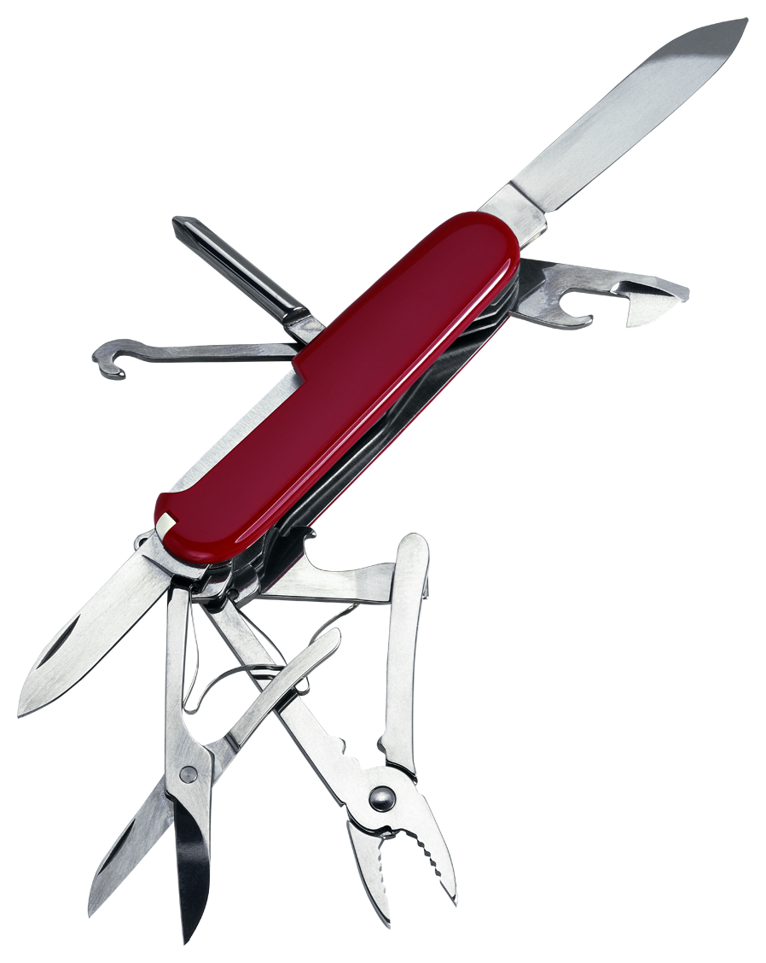
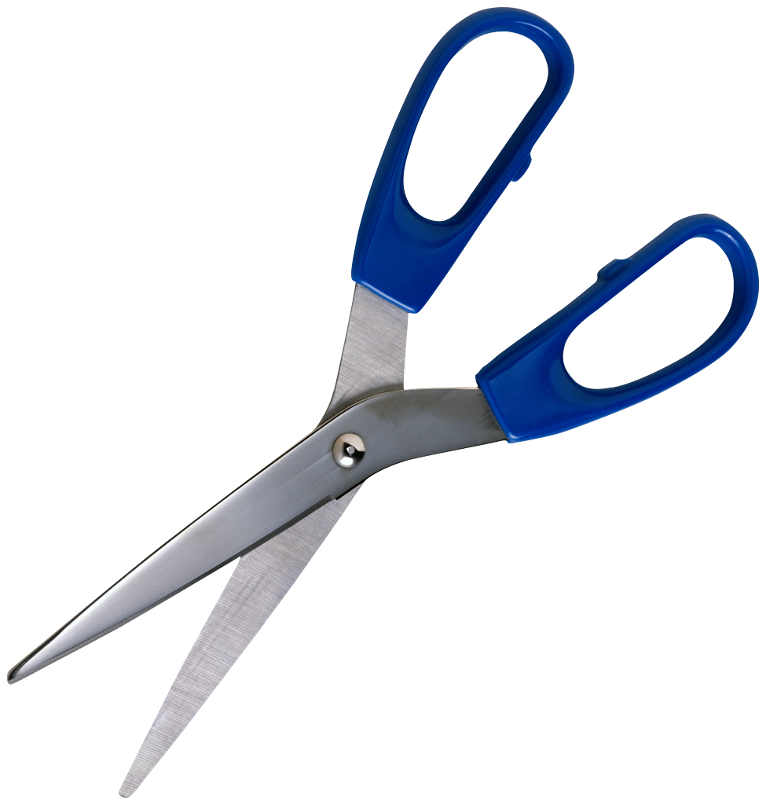
Minimum Viable Product (MVP)

Slide 6

Focus On Your Core Business

Slide 7
















Leverage Other People Work
Open Source
Software As A Service (SAAS)

Slide 8
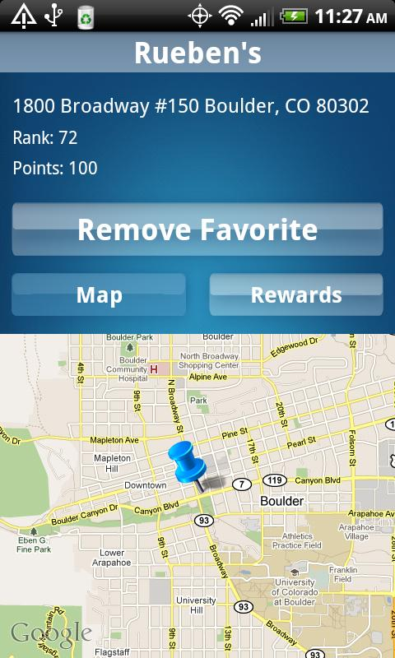

!NOT_INVENTED_HERE
Sweet, I just added Google Maps to my mobile app!
OR
Let’s see…if I download some map data
from a government website……..

Slide 9
SAAS Example
SIP service for ½ cent/min
Implement REST service
Setup SIP server
Code up sockets, channels, timeouts, queues, security, etc
But Making Phones Ring Is Not My Core Business!

Slide 10
Leveraging Twilio
Twilio makes phones ring for 2 cents/min
REST API
Development & Operations teams supporting platform
Well worth the extra cost

Slide 11





This Includes Tools
Code Repository
Team Collaboration
Requirements

Slide 12


Cloud Computing
Purchase Upfront
OR
Pay As You Go

Slide 13
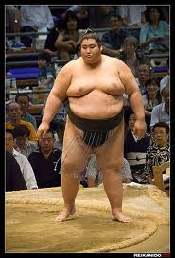
Act Like The Big Boys
Redundant servers in multiple datacenters
Databases with remote backup
Content distribution network
Load balancing
Server monitoring
Auto-scaling
High availability storage

Slide 14
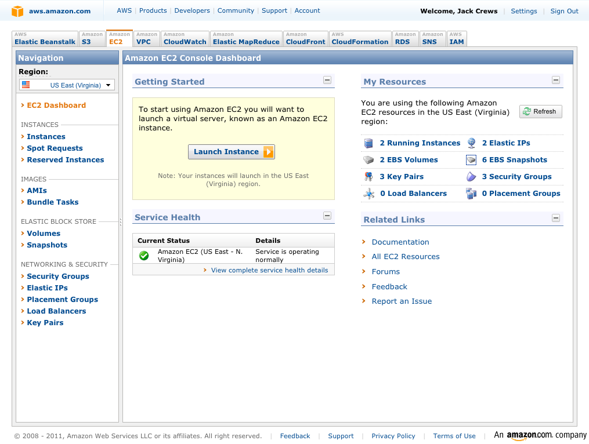
Configurable In A Console
For a few hundred a month!

Slide 15

Less Time On System Administration
Fewer Headaches

Slide 16
Amazon Relation Database Service
Configured from a console
Backups
Patches
Replication
Migrate to larger server on-demand

Slide 17
Powerful Combination
Short User Feedback Loops
Learn From Users
Implement Bare Minimum
Deploy to Cloud
Tell Everyone
Focus On Your Core Business
Cheap Resources
Pay As You Go

Slide 18



The Rules Of The Game Are Changing
Collaboration
Incognito
Rapid Feedback

Slide 19
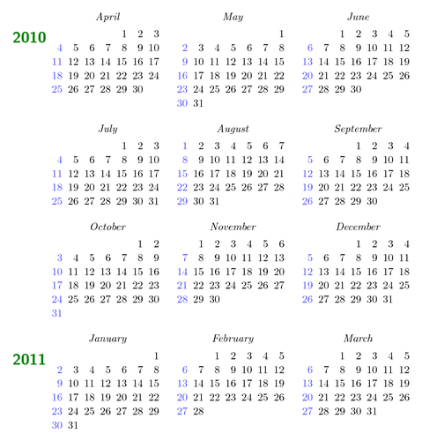
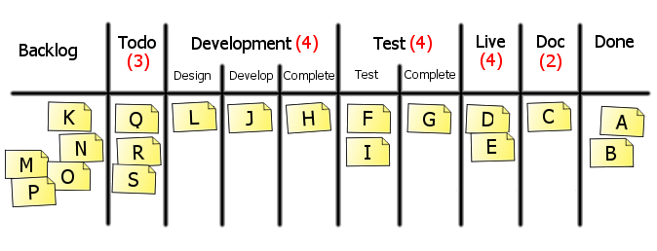
The Rules Of The Game Are Changing
Time To Market
Months or years
Days or weeks

Slide 20
The Rules Of The Game Are Changing
Upfront Capital
Significant
Just Enough

Slide 21
Everyone Can Play Now!
What company will you start?

